Slide 1
Alter Stored Procedures
Sometimes, you may want to alter a stored procedure by adding or removing parameters or even changing its body.
Fortunately, MySQL does not have any statement that allows you to directly modify the parameters and body of the stored procedure.
To make such changes, you must drop ad re-create the stored procedure using the DROP PROCEDURE and CREATE PROCEDURE statements.

Slide 2
Altering a stored procedure using MySQL Workbench
MySQL Workbench provides you with a good tool that allows you to change a stored procedure quickly.
First, create a stored procedure that returns the total amount of all sales orders:

Slide 3
DELIMITER $$
CREATE PROCEDURE GetOrderAmount()
BEGIN
SELECT
SUM(quantityOrdered * priceEach)
FROM orderDetails;
END$$
DELIMITER ;
Suppose that you want to get the total amount by a given sales order. So you need to add a parameter and change the code in the stored procedure.

Slide 4
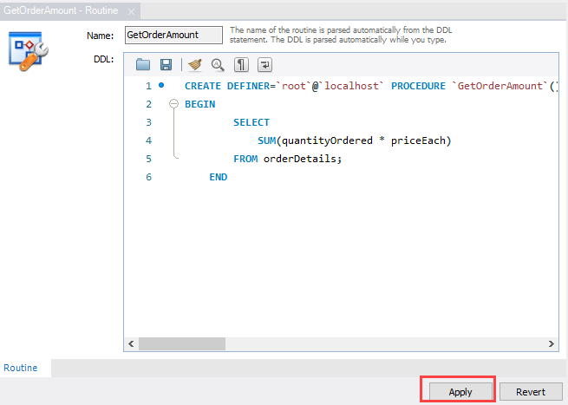
Second, right-click the stored procedure that you want to change and select Alter Stored Procedure…

Slide 5
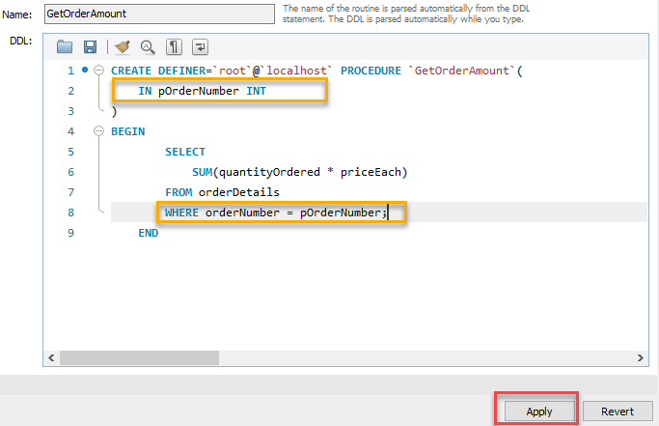
MySQL Workbench will open a new tab that contains the definition of the stored procedure.
Third, make the changes and click the Apply button.

Slide 6
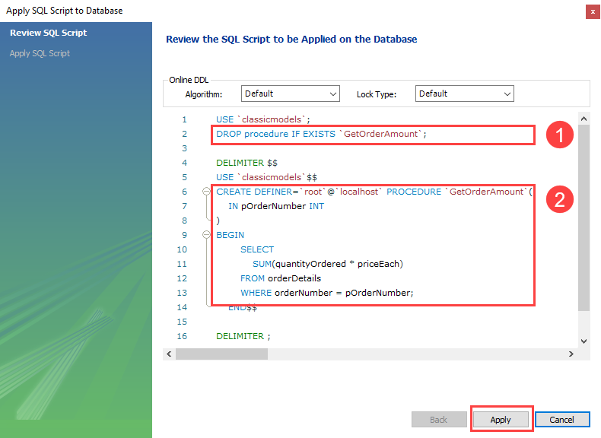
MySQL Workbench will display a SQL Script review window.

Slide 7
As you can see, it uses a sequence of DROP PROCEDURE and CREATE PROCEDURE statements to carry the modification.
Fourth, click the Apply button to execute the script.
MySQL Workbench will display a window that shows the status of the script execution.

Slide 8
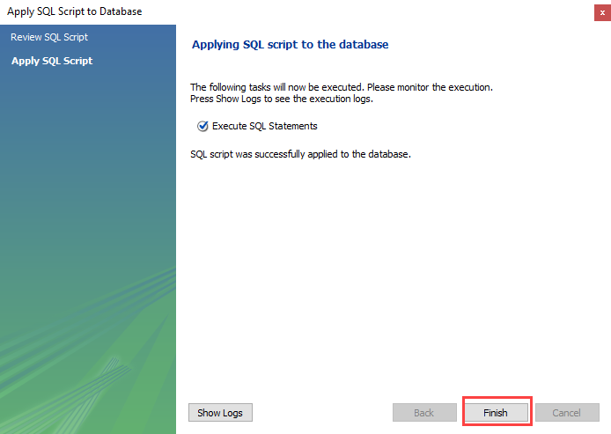

Slide 9
Thank You
Please Subscribe My Channel
https://www.youtube.com/channel/UCYW3PWPOPn3qgxxjhUbXXXg?view_as=subscriber

